Slide 1
Cloud Adoption Framework for Azure Labs
Technical (focus is on Ready, Adopt, Govern & Manage)
Target Audience: CSA, TSP, PTS, PFE, Specialists, Consultants
Notes:
Good morning everyone
Welcome to Cloud Adoption Framework for Azure
We have three action packed days with internal, partners and customers sessions
It's important that we are aware of and well versed in CAF delivery and assets
Julia White and Corey Sanders are pushing these knowledge to all in our organization
CAF is proven guidance to help our customers create and implement the business
and technology strategies necessary for their organizations to succeed in the cloud.
It provides best practices and tools that we and our partners can use to help
our customers to successfully achieve their short- and long-term objectives.
and to present this, please welcome Rob Kuehfus CAF Lead

Slide 2
Agenda
Start Time | Duration(mins) | Topic | CAF Phase | Type | Speaker / Proctor
8:30 AM | 30 | Introductions |  | Talk
9:00 AM | 30 | Strategy & Plan Overview | Strategy & Plan | Talk
9:30 AM | 30 | Ready Overview, Challenges & North Star Arch | Ready | Talk
10:00 AM | 15 | Implement the landing zone | Ready | Lab
10:15 AM | 15 | Break |  | Break
10:30 AM | 15 | Expand the Landing Zone | Ready | Talk
10:45 AM | 45 | Expand the Landing Zone (Network) | Ready | Lab
11:30 AM | 30 | Govern Overview | Govern | Talk
12:00 PM | 60 | Lunch |  | Lunch
1:00 PM | 15 | Governance Benchmark Tool | Govern | Lab
1:15 PM | 15 | Building a governance MVP | Govern | Talk
1:30 PM | 45 | Building a cloud governance MVP | Govern | Lab
2:15 PM | 15 | Break |  | Break
2:30 PM | 30 | Manage Overview | Manage | Talk
3:00 PM | 15 | Azure Architecture Review | Manage | Lab
3:15 PM | 15 | Business alignments and commitments | Manage | Talk
3:30 PM | 30 | Implement a Cloud Operations MVP | Manage | Lab
4:00 PM | 30 | Adopt Overview | Adopt | Talk
4:30 PM | 60 | Land your first workload | Adopt | Lab
5:30 PM | 30 | Recap &Next Steps (Engage) | Engage | Talk
6:00 PM |  | End |  | End

Slide 3
Lab Content
https://github.com/rkuehfus/CAFWorkshop
Download the repo to your local machine to find starter templates and script to help with each lab.

Slide 4
Workshop Lab A - Ready Implement the landing zone
Deploy the CAF Foundation landing zone blueprint to your subscription - https://docs.microsoft.com/en-us/azure/governance/blueprints/samples/caf-foundation/
Notes:
This questionnaire is designed to help you identify gaps in your organization across six key domains as defined in the Microsoft Cloud Adoption Framework. It provides a personalized report that outlines the difference between your current state and business priorities, and tailored resources to help you get started.

Slide 5
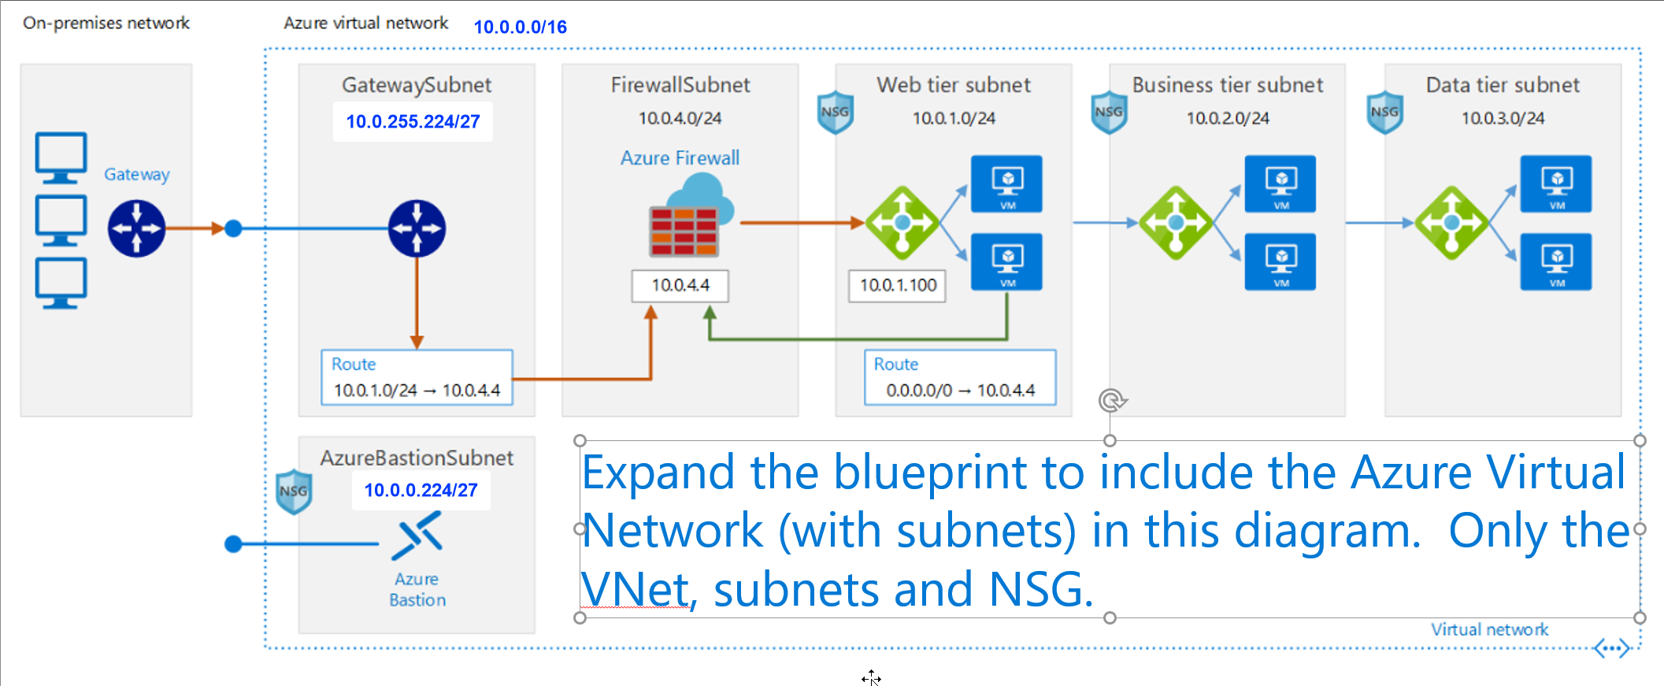
Workshop Lab B - Ready Expand the landing zone (Network)
Notes:
https://docs.microsoft.com/en-us/azure/architecture/reference-architectures/dmz/secure-vnet-dmz

Slide 6
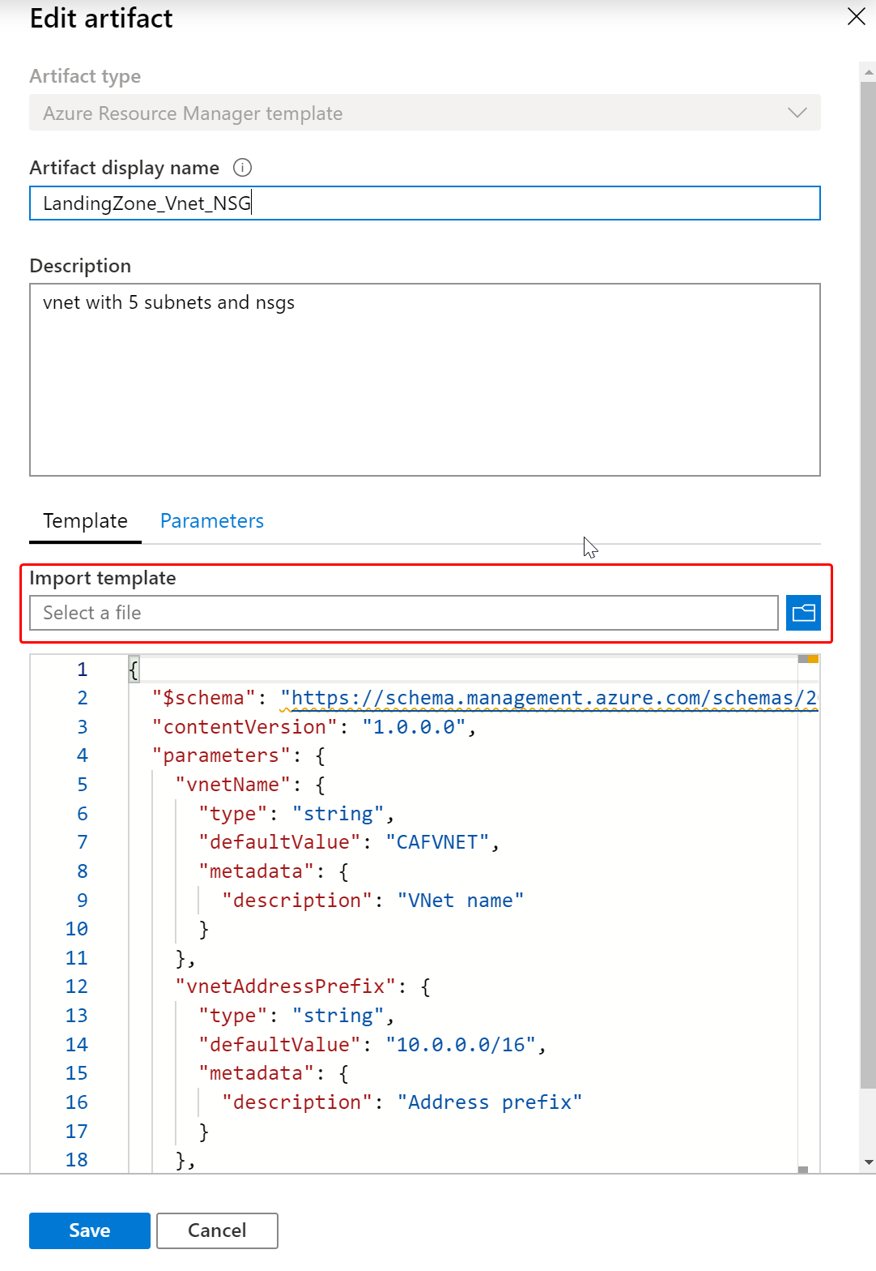
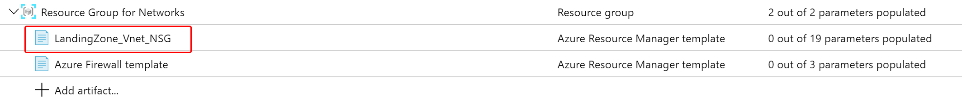
Workshop Lab B - Ready Example
Use this template in the CAFWorkshop GitHub under Student/Ready
https://github.com/rkuehfus/CAFWorkshop/blob/master/Student/Resources/Ready/CAFWorkshopLandingZoneVnet.json
Notes:
https://docs.microsoft.com/en-us/azure/architecture/reference-architectures/dmz/secure-vnet-dmz

Slide 7
Workshop Lab A - Govern Governance Assessment
Read the Customer situation (slides are in the section called Customer situation)
Fill out the Cloud Adoption Framework Governance Benchmark Tool based on the information on the Customer situation. Note: Some of the information will be incomplete so feel free to take some liberties with the benchmark tool.
Notes:
This questionnaire is designed to help you identify gaps in your organization across six key domains as defined in the Microsoft Cloud Adoption Framework. It provides a personalized report that outlines the difference between your current state and business priorities, and tailored resources to help you get started.

Slide 8
Workshop Lab B - Govern Building a Cloud Governance MVP
Based on the results of the Governance Benchmark Tool and the Customer situation prioritize and implement parts of the following:
Cost Management
Security baseline
Identity baseline
Resource consistency
Deployment acceleration
Note: Try to get through at least 3 of these

Slide 9
Workshop Lab B - Govern Examples:
Deploy Azure Firewall to improve security baseline for internet traffic – ARM template here
Create custom RBAC Role to restrict who can create resource groups and add to the blueprint at the Subscription level. Sample code here.
Export your Blueprint and copy/paste policies to create tagging policy and Import back into your Azure Sub. Sample code here.

Slide 10
Workshop Lab A - Manage Azure Architecture Review
Read the Customer situation (slides are in the section called Customer situation)
Examine your workload through the lenses of resiliency, cost, devops practices, security and scalability. https://docs.microsoft.com/en-us/assessments/?mode=pre-assessment&session=local
Notes:
Examine your workload through the lenses of resiliency, cost, devops practices, security and scalability

Slide 11
Workshop Lab B - Manage Implement a Cloud Operations MVP
Based on the results of the Azure Architecture Review and the Customer situation prioritize and implement an MVP for the following:
Inventory and Visibility
Operational compliance
Protect and recover
Note: Try to get through at least 3 of these

Slide 12
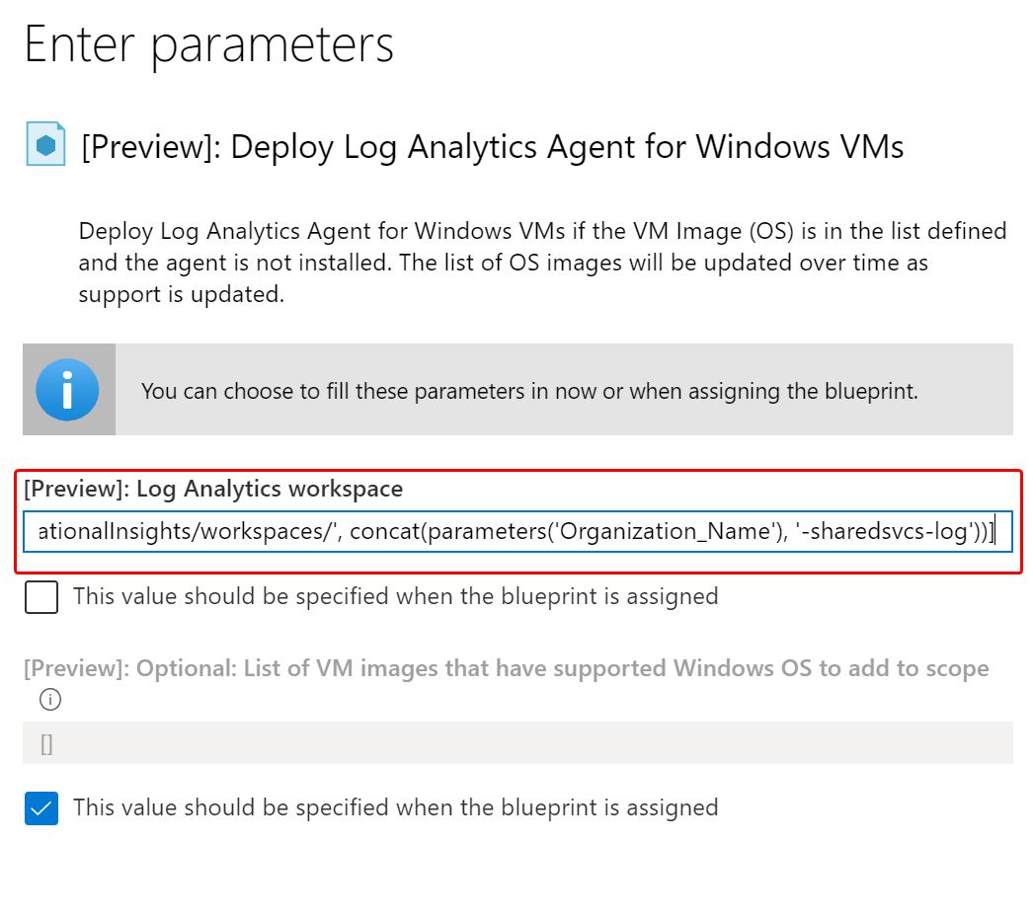
Workshop Lab B - Manage Example:
Address Protect & Recover by adding a Backup Vault. Sample template here. Make sure to add the backup policy as well to your first application.
Create a policy to Deploy all Log Analytics Agents to Windows VMs in the Subscription. Sample here.
Notes:
Examine your workload through the lenses of resiliency, cost, devops practices, security and scalability

Slide 13
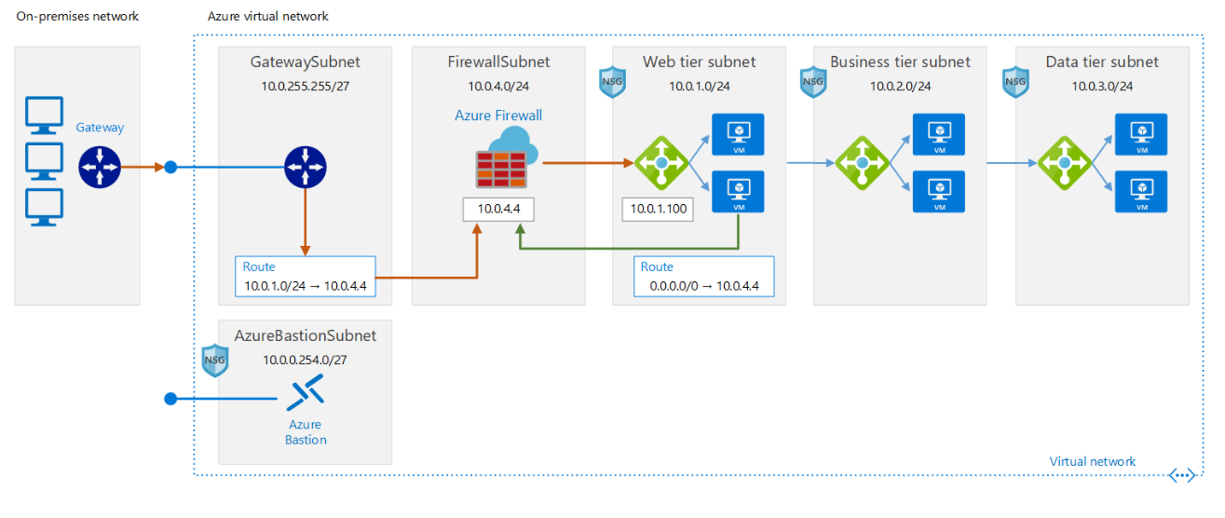
Workshop Lab A – Adopt - Migrate Land your first workload
Deploy the workloads to the landing zone to add VMs to each subnet, internal load balancers and Azure Bastion
Notes:
This questionnaire is designed to help you identify gaps in your organization across six key domains as defined in the Microsoft Cloud Adoption Framework. It provides a personalized report that outlines the difference between your current state and business priorities, and tailored resources to help you get started.

Slide 14
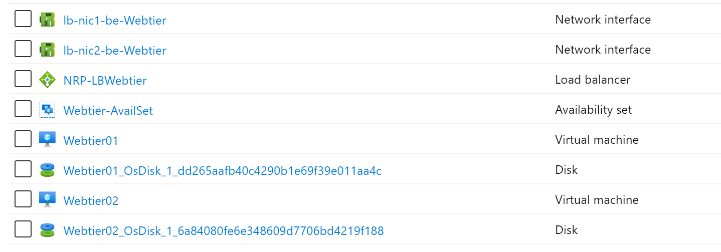
Workshop Lab A - Adopt Example:
Deploy your first workload however you wish. Feel free to use this sample PowerShell Script if you would like to try it out your Landing Zone.
Notes:
This questionnaire is designed to help you identify gaps in your organization across six key domains as defined in the Microsoft Cloud Adoption Framework. It provides a personalized report that outlines the difference between your current state and business priorities, and tailored resources to help you get started.

Slide 15
Customer situation
Trey Research
Consumer products manufacturing (Manufacturing and Resources) company
Annual revenues of USD $29.6 billion
10,000 - 14,999 Employees
Global company
Headquarters in New Jersey
Major offices in the UK, France, and Japan
Data centers and branch offices scattered across the United States
Looking to mitigate creeping costs as well as start the transition to a modern cloud enterprise architecture
Large EA commitment to Azure
Notes:
Trey Research is a manufacturing company that builds consumer products with 29.6 billion USD in annual revenue. Trey's headquarters are in New Jersey, but they have data centers and branch offices scattered across the United States with several major offices in the United Kingdom, France, and Japan.
Even as large as it is, Trey seeks to maximize the cost-effectiveness and flexibility of its IT, especially in new projects and business units. With a dizzying number of existing business units, each with its own unique requirements from IT and ballooning costs from internal hardware and data center investment, Trey is looking to the cloud.
Trey is interested in a large-scale solution that will help mitigate creeping costs and start the transition to a modern cloud-based enterprise architecture.
Trey's technical leadership has decided to move forward with a Microsoft enterprise agreement (EA) with a heavy commitment in Microsoft Azure.

Slide 16
Customer situation - Leadership
Ken Greenwald, Trey Research’s CTO
Understands the value of the cloud
Focus on best practices and controls
Wants to avoid mistakes that lead to trouble later on
Laura Knight, Head of Cloud Governance team
Reports to Ken
Responsible for defining, implementing and enforcing Azure governance
Works with other teams to ensure best practices are adopted
Wants to adopt Microsoft's Cloud Adoption Framework as a baseline for Azure governance
Notes:
Trey Research's CTO, is aware of the potential for the cloud, but also has a keen understanding that without strong governance, Trey may end up with an environment that lacks essential business controls. These incorrect practices can then be disbursed across the enterprise, leading to an unmanageable Azure estate and costs which are hard to track or control. Ken wants to start on the right foot by enforcing common-sense best practices from the start.
Enterprise IT is responsible for managing corporate network connectivity, datacenter distribution, capacity planning, identity, and enterprise wide SaaS services for Trey Research employees. Enterprise IT is also responsible for supporting the services, datacenters, and setting auditing policy on hardware and services.
To help drive Azure adoption and best practices, Ken has chartered a Cloud Governance team within Enterprise IT, headed by Laura Knight. This team will be responsible for all aspects of Azure governance. This includes defining, implementing and enforcing cloud governance and working with other teams to ensure best practices are adopted.
Rather than re-invent the wheel, the Cloud Governance team have decided to adopt Microsoft's Cloud Adoption Framework as a baseline upon which they will build their governance implementation. This framework is divided into five disciplines.

Slide 17
Customer situation - Business strategy and focus
Short-term (Horizon 1)
Reliability, Scalability, Agility, Security - Datacenter exit Q2
Profitability - Ability to provide cost of acquisition/operations for partners
Business Value Realization - Financial justification
Medium-term (Horizon 2)
Optimize Operations - Data segmentation for business partners
Innovation - Enable developers and business units to rapidly build new services
Long-term (Horizon 3)
Enable Business Agility - Move existing assets to micro services as a means of driving greater efficiency

Slide 18
Customer situation - Business justification
Trey Research seeks to create a financial model to showcase the long-term cash savings of the migration. In addition, provide deeper analytics for the fully burdened cost by partner enabling the ability to increase profitability. Microsoft can partner with Trey Research financial teams to build out a financial modelling to support the onboarding of new partners.

Slide 19
Customer situation - Organizational alignment
Cloud Strategy Team
Finance
Line of business
Human resources
Operations
Enterprise architecture
IT infrastructure
Application groups
Project managers (Often with Agile project management experience)
Cloud Governance Team
IT governance
Enterprise architecture
Security
IT operations
IT infrastructure
Networking
Identity
Virtualization
Business continuity and disaster recovery
Application owners within IT
Finance owners
Notes:
It is essential that as we adopt cloud we think about the individuals and roles that they will play in the future service delivery model. As iterated before “Cloud is a model, not just a place”. This will mean that we need to thing about how we leverage teams to be more agile and respond to ever changing demands. We need to ensure that the teams can help drive alignment and accountability.
There are many ways that we can align the organization, the recommendations below are based on what we see with other customers and will start with the principle of a minimal viable product (MVP) and then evolve as Contoso progresses with the adoption.
Our guidance is to start with 2 teams, a Cloud Strategy Team and a Cloud Governance Team
The Cloud Strategy Team is responsible for leading the cloud adoption within your organization, supporting all business outcomes, people and processes changes and technical projects identified within this plan. The types of roles typically found in the strategy team are:
Finance
Line of business
Human resources
Operations
Enterprise architecture
IT infrastructure
Application groups
Project managers (Often with Agile project management experience)
The Cloud Governance Team ensures that risks and risk tolerance are properly evaluated and managed. This capability ensures the proper identification of risks that can't be tolerated by the business have the correct governing corporate policies. Here are some of the roles which we believe form part of your Governance team:
IT governance
Enterprise architecture
Security
IT operations
IT infrastructure
Networking
Identity
Virtualization
Business continuity and disaster recovery
Application owners within IT
Finance owners

Slide 20
IT organization
Each business unit has its own IT resources and IT budget
Track and alert on costs by business unit, project, and workload type
Delegate management to business unit IT
Trey Research
Industrial & Consumer
Electronics
Life Sciences
Product
Development
Marketing
Sales & Support
Product
Development
Marketing
Sales & Support
Product
Development
Marketing
Sales & Support
Regional (US/EU/Asia)
Regional (US/EU/Asia)
Regional (US/EU/Asia)
Notes:
Trey Research has three business units: Industrial and Consumer, Electronics, and Life Sciences. Each of the Business Units has the same subunits: Product development, Marketing, and Sales and Support. Sales and Support is further divided into region subunits (US/EU/Asia).

Slide 21
Customer situation
Sprawling IT estate, including a substantial legacy server footprint
Windows servers including both x32 and x64 hardware running Windows Server 2003 through to 2016
Linux servers running a mix of RHEL 6.10 and 7 series (7.2 through 7.6) and Ubuntu 16.04
The above servers comprise both physical machines as well as VMs hosted on VMware infrastructure managed by vCenter 6.5
Multiple database engines, including Microsoft SQL Server, PostGreSQL, and Cassandra
448 servers identified
No clear view of entire estate
Notes:
The CTO Ken Greenwald, was hired 6 months ago from outside the company, with a mandate to address ever-increasing IT costs. He has identified a sprawling IT estate, including a substantial legacy server footprint. New servers and services have been accumulated over time, without consolidating existing infrastructure. This includes:
- Windows servers including both x32 and x64 hardware running Windows Server 2003 through to 2016
- Linux servers running a mix of RHEL 6.10 and 7 series (7.2 through 7.6) and Ubuntu 16.04
- The above servers comprise both physical machines as well as VMs hosted on VMware infrastructure managed by vCenter 6.5
- Multiple database engines, including Microsoft SQL Server, PostgreSQL, and Cassandra
In total, 448 servers and VMs have been identified to date, distributed across 5 main locations, all in the US. There is a complex web of dependencies between servers and no-one has a clear view of the entire estate. Fear of breaking an existing system has been one of the drivers of server count and sprawl.

Slide 22
Customer Needs—Cost Management
Provide cost management tools for budgets, alerts, dashboards, spending reports, forecasts, anomaly detection and investigation, and cost-saving recommendations
Implement a charge back mechanism for the business units for resources they consume based on the IO code for each application
Enable allocation of costs between categories: Development and Test, Production, Support Services, and Infrastructure
Notes:
Each business unit and subunit is allocated an Azure quota/budget and is responsible for tracking their expenditure within that budget. Within a business unit, each new project should track its consumption using a specific tag for its IO code within the business unit.
In addition, each business unit has a requirement to break down their costs into the following categories. Accurate allocation of costs between this categories is essential, since this data feeds into gross margin and net profit figures collated by the central finance team and published quarterly to investors.
- Development and Test
- Production
- Support Services
- Infrastructure
Business units and the finance department need tools to accurately and reliably track all Azure costs, including a cost management dashboard and reports to understand current costs and projected future costs. Alerts when budgets are approached or exceeded are required.
In addition, the Cloud Governance team's charter includes company-wide monitoring and reporting of all Azure spend, including reviewing usage to identify cost-saving opportunities and identifying and investigating anomalous spending.

Slide 23
Customer Needs—Cost Management Controls Backlog
You should associate all assets deployed to the cloud with a billing unit and application/workload. This policy will ensure that future Cost Management efforts will be effective.
Notes:
Each business unit and subunit is allocated an Azure quota/budget and is responsible for tracking their expenditure within that budget. Within a business unit, each new project should track its consumption using a specific tag for its IO code within the business unit.
In addition, each business unit has a requirement to break down their costs into the following categories. Accurate allocation of costs between this categories is essential, since this data feeds into gross margin and net profit figures collated by the central finance team and published quarterly to investors.
- Development and Test
- Production
- Support Services
- Infrastructure
Business units and the finance department need tools to accurately and reliably track all Azure costs, including a cost management dashboard and reports to understand current costs and projected future costs. Alerts when budgets are approached or exceeded are required.
In addition, the Cloud Governance team's charter includes company-wide monitoring and reporting of all Azure spend, including reviewing usage to identify cost-saving opportunities and identifying and investigating anomalous spending.

Slide 24
Customer Needs—Security Baseline
Enable investigation of changes leading up to any outage
Who, when, what – including before/after state for each Azure resource
Azure resources and in-VM configuration
Ensure Windows and Linux VMs meet password complexity requirements
Enable logging across all components (identity, virtual network, virtual machine, web, and database) to support an all-encompassing monitoring solution.
Notes:
The IT security team have advised a precautionary approach to cloud adoption. The Cloud Governance team are keen to adopt a strong set of best practices to make sure the IT security and business teams feel comfortable to avoid security becoming an adoption blocker.
If a service has an outage, it is important to know the chain of events that led up to the outage and who (if anyone) caused it.
IT security require that all Azure VMs (Windows and Linux) meet their password complexity requirements. They also require that only approved OS images are used as the baseline for any VM.

Slide 25
Customer Needs—Security Baseline
Setup auditing such that software installs are monitored across Azure virtual machine resources.
When specific security events are detected (such as a port scan), allow for the execution of actions to remediate, start the investigative process or prevent further information leakage or damage
The organization's security gateways (e.g. firewalls) enforce security policies and are configured to filter traffic between domains, block unauthorized access, and are used to maintain segregation between internal wired, internal wireless, and external network segments (e.g., the Internet) including DMZs and enforce access control policies for each of the domains.
Notes:
The IT security team have advised a precautionary approach to cloud adoption. The Cloud Governance team are keen to adopt a strong set of best practices to make sure the IT security and business teams feel comfortable to avoid security becoming an adoption blocker.
If a service has an outage, it is important to know the chain of events that led up to the outage and who (if anyone) caused it.
IT security require that all Azure VMs (Windows and Linux) meet their password complexity requirements. They also require that only approved OS images are used as the baseline for any VM.

Slide 26
Customer Needs—Security Baseline Controls Backlog
Awareness of VMs in violation of the password strength policy helps you take corrective actions to ensure passwords for all VM user accounts are compliant with policy.
[Preview]: Deploy VM extension to audit Windows VM enforces password complexity requirements
[Preview]: Deploy VM extension to audit Windows VM maximum password age 70 days
[Preview]: Deploy VM extension to audit Windows VM minimum password age 1 day
[Preview]: Deploy VM extension to audit Windows VM passwords must be at least 14 characters
[Preview]: Deploy VM extension to audit Windows VM should not allow previous 24 passwords
[Preview]: Audit Windows VM enforces password complexity requirements
[Preview]: Audit Windows VM maximum password age 70 days
[Preview]: Audit Windows VM minimum password age 1 day
[Preview]: Audit Windows VM passwords must be at least 14 characters
[Preview]: Audit Windows VM should not allow previous 24 passwords
Notes:
Trey Research has deployed Office 365 and it is configured with federated access to their ADFS servers. Trey's EA has been created within the same organization.
Providing the ability to delegate permissions to different administrators at the business unit and subunit level is critical. However, for an organization the size of Trey Research, it is not possible for the Cloud Governance team to manage all user permissions centrally. Instead, for each new project, an administrator in the business unit should be able to manage access for his or her team. The business unit administrator must not be able to override or circumnavigate governance rules defined by the Cloud Governance team. Team members must be provide the access they need, to the resources they need, but no more. To maintain consistency and to enable Cloud Governance team audit, Azure access should be controlled using built-in roles only, not custom roles.
The Trey e-commerce team make significant use of contingent staff. At present, these staff are granted identities in the existing Trey directory, and are required to work on-site to gain access to Trey development and test environments. Trey would like to streamline this process and enable remote working.

Slide 27
Customer Needs—Resource Consistency
Allow the Cloud Governance team to control which Azure services can be used across the business units, while allowing controlled exceptions
Control resource types and expensive configurations within common resource types
Restrict Resourcegroup creation to approved groups
Exceptions must be limited to a specific resource type and resource group
Prevent accidental deletion of resources
Implement a common resource naming standard across the organization
Notes:
While the Cloud Governance team is not yet familiar with the full range of Azure services available. They want to limit Trey's Azure adoption to an initial set of core services and locations, which will be expanded over time. These should be centrally enforced, with the ability to grant exceptions where required (for example, for teams piloting new technologies, or one-off deployments of a shared resource such as an ExpressRoute circuit).
The IT Security team is particularly concerned about production environments. These require additional controls to ensure that resources cannot be accidentally modified or deleted by administrators getting confused between a test workload versus production.
To maintain consistency, the Cloud Governance team is developing a set of naming conventions. These names will apply to subscriptions, resource groups and resources. Trey require the ability to enforce this naming convention consistently across their Azure subscriptions.

Slide 28
Customer Needs—Resource Consistency Control Backlog
Rules that are too permissive may allow unintended network access and should be reviewed. Monitor unprotected endpoints, applications, and storage accounts. Endpoints and applications that aren't protected by a firewall, and storage accounts with unrestricted access can allow unintended access to information contained within the information system.
Audit unrestricted network access to storage accounts
Access through Internet facing endpoint should be restricted
Allowed locations
Allowed locations for resource groups
Audit use of classic storage accounts
Audit use of classic virtual machines
Audit VMs that do not use managed disks
Notes:
While the Cloud Governance team is not yet familiar with the full range of Azure services available. They want to limit Trey's Azure adoption to an initial set of core services and locations, which will be expanded over time. These should be centrally enforced, with the ability to grant exceptions where required (for example, for teams piloting new technologies, or one-off deployments of a shared resource such as an ExpressRoute circuit).
The IT Security team is particularly concerned about production environments. These require additional controls to ensure that resources cannot be accidentally modified or deleted by administrators getting confused between a test workload versus production.
To maintain consistency, the Cloud Governance team is developing a set of naming conventions. These names will apply to subscriptions, resource groups and resources. Trey require the ability to enforce this naming convention consistently across their Azure subscriptions.

Slide 29
Customer Needs—Identity Baseline
Delegate access management to business units for each application they own
Business unit administrators should not be able to change or override policies defined by the Cloud Governance team
Ensure staff have access to what they need, but no more, while enforcing that only built-in roles are used
Identify a solution to streamline identity management and provide remote access for e-commerce team contingent staff
Notes:
Trey Research has deployed Office 365 and it is configured with federated access to their ADFS servers. Trey's EA has been created within the same organization.
Providing the ability to delegate permissions to different administrators at the business unit and subunit level is critical. However, for an organization the size of Trey Research, it is not possible for the Cloud Governance team to manage all user permissions centrally. Instead, for each new project, an administrator in the business unit should be able to manage access for his or her team. The business unit administrator must not be able to override or circumnavigate governance rules defined by the Cloud Governance team. Team members must be provide the access they need, to the resources they need, but no more. To maintain consistency and to enable Cloud Governance team audit, Azure access should be controlled using built-in roles only, not custom roles.
The Trey e-commerce team make significant use of contingent staff. At present, these staff are granted identities in the existing Trey directory, and are required to work on-site to gain access to Trey development and test environments. Trey would like to streamline this process and enable remote working.

Slide 30
Customer Needs—Identity Baseline Controls Backlog
[Preview]: Audit deprecated accounts on a subscription
[Preview]: Audit deprecated accounts with owner permissions on a subscription
[Preview]: Audit external accounts with owner permissions on a subscription
[Preview]: Audit external accounts with write permissions on a subscription
Notes:
Trey Research has deployed Office 365 and it is configured with federated access to their ADFS servers. Trey's EA has been created within the same organization.
Providing the ability to delegate permissions to different administrators at the business unit and subunit level is critical. However, for an organization the size of Trey Research, it is not possible for the Cloud Governance team to manage all user permissions centrally. Instead, for each new project, an administrator in the business unit should be able to manage access for his or her team. The business unit administrator must not be able to override or circumnavigate governance rules defined by the Cloud Governance team. Team members must be provide the access they need, to the resources they need, but no more. To maintain consistency and to enable Cloud Governance team audit, Azure access should be controlled using built-in roles only, not custom roles.
The Trey e-commerce team make significant use of contingent staff. At present, these staff are granted identities in the existing Trey directory, and are required to work on-site to gain access to Trey development and test environments. Trey would like to streamline this process and enable remote working.

Slide 31
Customer Needs—Deployment Acceleration
Implement deployment automation while allowing controlled divergence between environments
E.g. smaller footprint for Dev/Test environments
Provide a means to track and update existing best-practice reference implementation deployments to meet updated best practices
Provide a means to prevent best-practice reference implementation deployments being modified outside the control of the Cloud Governance team
Notes:
Increased agility is one of Trey's primary motivation for adopting the cloud. They are keen to take full advantage of deployment automation to enable agile processes that will enable them to update their services more frequently and easily.
However, they are also concerned about how to maintain consistency and control across environments. They are concerned that production and test environments may diverge over time. However, they can't use identical automation in both environments, since test environments are often scaled differently to production to save costs.
The Cloud Governance team has developed best-practice reference implementations for commonly-deployed services, such as a DMZ network or a pair of web servers. They are looking for a way to automate these deployments. They recognize that these best practices will evolve over time, and so are also looking for a way to track existing deployments to ensure updates are rolled out consistently. In addition, where resources are deployed following Cloud Governance team best practices, individual business units should not be able to modify the configuration of those resources.

Slide 32
Customer Needs—Deployment Acceleration Controls Backlog
Key metrics and diagnostics measures will be identified for all production systems and components, and monitoring and diagnostic tools will be applied to these systems and monitored regularly by operations personnel.
Operations will consider using monitoring and diagnostic tools in nonproduction environments such as Staging and QA to identify system issues before they occur in the production environment.
Notes:
Increased agility is one of Trey's primary motivation for adopting the cloud. They are keen to take full advantage of deployment automation to enable agile processes that will enable them to update their services more frequently and easily.
However, they are also concerned about how to maintain consistency and control across environments. They are concerned that production and test environments may diverge over time. However, they can't use identical automation in both environments, since test environments are often scaled differently to production to save costs.
The Cloud Governance team has developed best-practice reference implementations for commonly-deployed services, such as a DMZ network or a pair of web servers. They are looking for a way to automate these deployments. They recognize that these best practices will evolve over time, and so are also looking for a way to track existing deployments to ensure updates are rolled out consistently. In addition, where resources are deployed following Cloud Governance team best practices, individual business units should not be able to modify the configuration of those resources.

Slide 33
Customer objections
Per-subscription configuration won't scale to an organization the size of Trey Research. How can governance controls be implemented with minimum per-subscription configuration overhead?
As well as implementing our governance rules on how Azure is used, we need a way to audit that no deployments have been made that bypass those rules. This audit needs to scale across the entire organization.

Slide 34
Customer objections
How can we ensure our deployments meet Azure security best practices, and how can we protect our Production workloads even if the security perimeter is compromised?
How can Azure help control the costs associated with non-Production VMs left running out-of-hours?

